Slide 1
Sales Performance Analysis
KPI Metrics and Visual Mapping Dashboard
This dashboard provides a comprehensive analysis of product performance, revenue trends, profitability, and market behavior using sales data.
Name: Pragada Vishnu Priya
Date: 8-07-2025

Slide 2
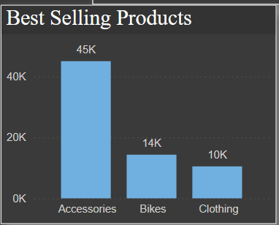
Best Selling Product
Chart Type: Bar Chart
Explanation:
Insight:
Accessories are the top-selling products with over 45K units sold, followed by bikes and clothing.
Interpretation:
High sales volume may indicate strong demand, lower price, or wider usage of accessories.

Slide 3
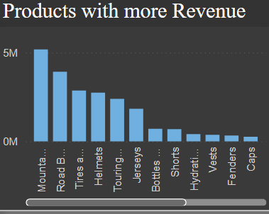
Products with more revenue
Chart Type: Clustered Column chart.
Explanation:
Insight:
Despite lower sales volume, Mountain Bikes and Road Bikes generate the highest revenue.
Interpretation:
These items are likely higher-priced or have higher profit margins.

Slide 4
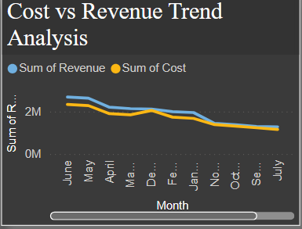
Cost vs Revenue Trend Analysis
Chart Type: Line Chart
Explanation:
Insight:
Revenue generally exceeds cost across months, suggesting profitability.
Highlight:
Watch for months where revenue dips or closely matches costs, indicating possible inefficiencies.

Slide 5
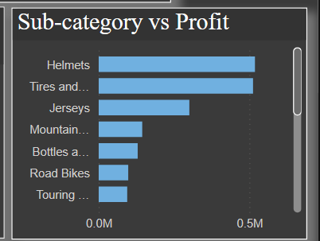
Sub-Category vs Profit
Chart Type: Bar Chart
Explanation:
Insight:
Helmets and Tires contribute the most to profit.
Interpretation:
Sub-categories with high profitability should be prioritized in marketing and inventory decisions.

Slide 6
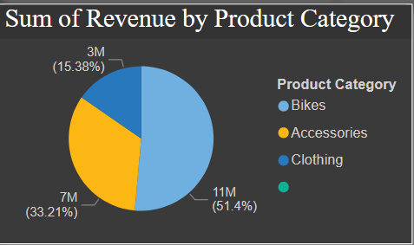
Sum of Revenue by Product Category
Chart Type: Pie Chart
Explanation:
Insight:
Clothing contributes over 50% of the total revenue, followed by Accessories (33%) and Bikes (15%).
Interpretation:
Revenue does not always align with units sold — pricing and margin play a role.

Slide 7
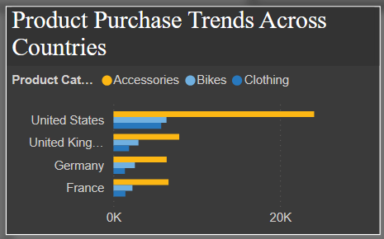
Product Purchase Trends Across Countries
Chart Type: Bar Chart
Explanation:
Insight:
The United States leads in purchases, especially for Accessories.
Interpretation:
Regional focus can guide promotional strategies and inventory distribution.

Slide 8
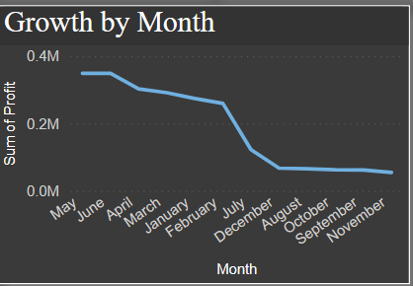
Growth by Month
Chart Type: Line Chart
Explanation:
Insight:
Peak profits were in May and June, with a decline from July to November.
Interpretation:
This may reflect seasonal trends or declining marketing efforts in later months.

Slide 9
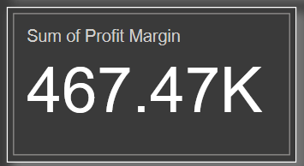
Sum of Profit Margin
Chart Type: KPI Card
Explanation:
Value:
Total Profit Margin = 467.47K
Interpretation:
A key performance indicator for overall profitability and cost efficiency.

Slide 10
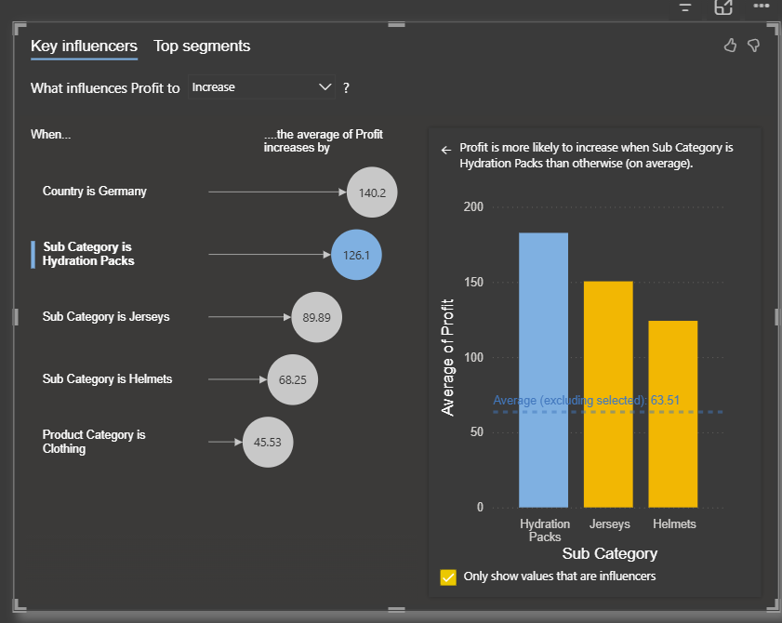
Key Influencers
Chart Type: AI Visual (Power BI)
Explanation:
Insight:
Displays which factors most influence profit.
Example Interpretation:
“When sub-category is Hydration packs, profit increases significantly.”
Helps in decision-making and understanding the drivers of profit.

Slide 11
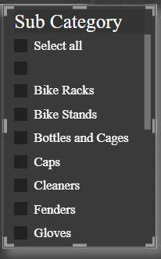
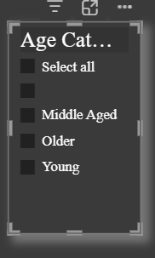

Filters and Interactivity
Explanation:
Slicers include:
Month
Age Category
Sub-Category
Interpretation:
These allow users to drill down into specific segments, timeframes, or customer groups for deeper insights.

Slide 12
Summary
High profitability in accessories and sub-categories like helmets.
Clothing contributes the most to revenue.
Focus on maintaining strong performance in the US market.
Investigate and address the mid-year drop in growth.

